Slide 1

Introduction to CSS3
By Tamal Dey
Assistant Professor,
Dept. of MCA
PESIT

Slide 2
Index
Selectors
Box Model
Backgrounds and Borders
Image Values and Replaced Content
Text Effects
2D/3D Transformations
Animations

Slide 3
Introduction
CSS3 is the latest standard for Cascading Style Sheet
CSS3 has been split into "modules".
It contains the "old CSS specification"
which has been split into smaller pieces
In addition, new modules are added
CSS3 Modules are W3C Recommendations, and most of the new CSS3 properties are already implemented in modern browsers.
CSS3 is a cascading piece of paper that specifies concerning the data with a joined hypertext mark-up language document displays.

Slide 4
CSS3 History
The first working draft of CSS3 was came in 2001and since the first introduction still it is under construction.
There were some certain shortcomings in CSS2 and due to its unlikeness the developer introduced CSS3.
It was initially declared early in the June 1999.

Slide 5
CSS3 Borders
A CSS3 Border is such an affords of style sheet which reduces the human efforts of Photoshop and other graphical applications.
An individual can create the rounded borders, border shadow, imaged based border etc. with the help of CSS3 Border.
Basically we use three features to create the border:
Border-radius
Border-image

Slide 6
border-radius is a such properties of CSS3 by which we can create the rounded corners.
border-image is a such properties of CSS3 by which we can create the customized border, as we can put our own image as border.

Slide 7
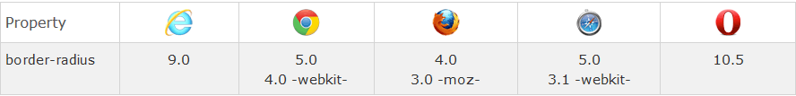
CSS3 Rounded Corners
CSS3 border-radius property, you can give any element "rounded corners” in 3 ways
Rounded corners for an element with a specified background color
Rounded corners for an element with a border
Rounded corners for an element with a background image
-webkit- or -moz- specify the first version that worked with a prefix.

Slide 8
CSS3 border-radius - Specify Each Corner
border-radius property radius will be applied to all 4 corners.
Four values: first value applies to top-left, second value applies to top-right, third value applies to bottom-right, and fourth value applies to bottom-left corner
Three values: first value applies to top-left, second value applies to top-right and bottom-left, and third value applies to bottom-right
Two values: first value applies to top-left and bottom-right corner, and the second value applies to top-right and bottom-left corner
One value: all four corners are rounded equally

Slide 9
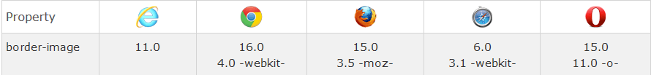
CSS3 Border Images
CSS3 border-image property, you can set an image to be used as the border around an element
The property has three parts:
The image to use as the border
Where to slice the image
Define whether the middle sections should be repeated or stretched
border-image property takes the image and slices it into nine sections, like a tic-tac-toe board. It then places the corners at the corners, and the middle sections are repeated or stretched as you specify.

Slide 10
CSS3 Shadow Effects
box-shadow is a such properties of CSS3 by which we can create the shadow of border.
Add shadow to text and to elements by this following properties
text-shadow
Multiple Shadows in Text
Add more than one shadow to the text, you can add a comma-separated list of shadows.
CSS3 box-shadow Property
box-shadow property applies shadow to elements

Slide 11
CSS3 Backgrounds
A few css3 background properties, which allow greater control of the background element.
Here we learn how to add multiple background images to one element.
Different background images are separated by commas, and the images are stacked on top of each other, where the first image is closest to the viewer.
Also following new CSS3 background properties:
background-size : allows you to specify the size of image.
background-origin: specifies where the image is positioned
background-clip: specifies painting area of the background.

Slide 12
CSS3 background-origin Property
background-origin property specifies where the background image is positioned
The property takes three different values:
border-box - the background image starts from the upper left corner of the border
padding-box - (default) the background image starts from the upper left corner of the padding edge
content-box - the background image starts from the upper left corner of the content

Slide 13
CSS3 background-clip Property
Specifies the painting area of the background
property takes three different values:
border-box - (default) the background is painted to the outside edge of the border
padding-box - the background is painted to the outside edge of the padding
content-box - the background is painted within the content box

Slide 14

CSS3 Colors
CSS supports color names, hexadecimal and RGB colors.
In addition, CSS3 also introduces:
RGBA colors
HSL colors
HSLA colors
opacity
RGBA color values are an extension of RGB color values with an alpha channel - which specifies the opacity for a color.
rgba(red, green, blue, alpha).
alpha parameter is a number between 0.0 (fully transparent) and 1.0 (fully opaque) - Not transmitting light.

Slide 15

HSL Colors
HSL stands for Hue, Saturation and Lightness.
Hue is a degree on the color wheel (from 0 to 360):
0 (or 360) is red
120 is green
240 is blue
Saturation is a percentage value: 100% is the full color.
Lightness is also a percentage; 0% is dark (black) and 100% is white.
Notes:
Hue:The quality of a colour as determined by its dominant wavelength

Slide 16

HSLA Colors
HSLA color values are an extension of HSL color values with an alpha channel - specifies the opacity for a color.
An HSLA color value is specified with:
hsla(hue, saturation, lightness, alpha), where the alpha parameter defines the opacity.
The alpha parameter is a number between 0.0 (fully transparent) and 1.0 (fully opaque).

Slide 17



Opacity
The CSS3 opacity property sets the opacity for a specified RGB value.
The opacity property value must be a number between 0.0 (fully transparent) and 1.0 (fully opaque).
opaque : Not transmitting light or other radiation

Slide 18
CSS3 Gradients
CSS3 gradients let you display smooth transitions between two or more specified colors.
CSS3 gradients you can reduce download time and bandwidth usage. (i.e Image Earlier)
Elements with gradients look better when zoomed, because the gradient is generated by the browser.
CSS3 defines two types of gradients:
Linear Gradients (goes down/up/left/right/diagonally)
Radial Gradients (defined by their center)

Slide 19

CSS3 Linear Gradients
To create a linear gradient you must define at least two color stops.
Color stops are the colors you want to render smooth transitions among.
Set a starting point and a direction (or an angle) along with the gradient effect.
Syntax
background: linear-gradient(direction, color-stop1, color-stop2, ...);
background: linear-gradient(angle, color-stop1, color-stop2);

Slide 20
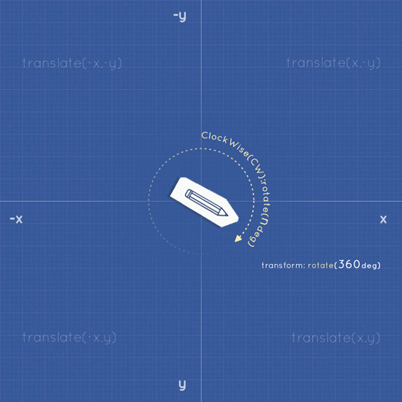
Linear Gradient
Top to Bottom (this is default)
Left to Right
Diagonal
Degree
Text

Slide 21

CSS3 Radial Gradient
A radial gradient is defined by its center.
To create a radial gradient you must also define at least two color stops.
Syntax
background: radial-gradient(shape size at position, start-color, ..., last-color);
Default, shape is ellipse, size is farthest-corner, and position is center.
Evenly Spaced Color Stops (this is default)
repeating-radial-gradient() function

Slide 22
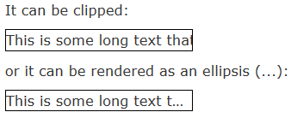
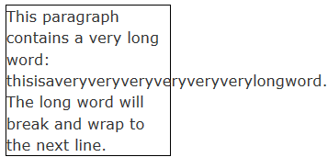
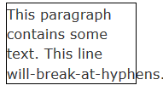
CSS3 Text
CSS3 contains several new text features.
text-overflow : property specifies how overflowed content that is not displayed should be signalled to the user. It can be clipped.
word-wrap: property allows long words to be able to be broken and wrap onto the next line.
word-break: property specifies line breaking rules.

Slide 23
CSS Web Fonts
Web fonts allow Web designers to use fonts that are not installed on the user's computer.
The font you wish to use, just include the font file on your web server, and it will be automatically downloaded to the user when needed.
Your "own" fonts are defined within the CSS3 @font-face rule.

Slide 24
Different Web Fonts
TrueType Fonts (TTF): TrueType is a font standard developed in the late 1980s, by Apple and Microsoft.
OpenType Fonts (OTF): OpenType is a format for scalable computer fonts. It was built on TrueType, and is a registered trademark of Microsoft.
The Web Open Font Format (WOFF): Developed in 2009, and is now a W3C Recommendation. WOFF is essentially OpenType or TrueType with compression and additional metadata.

Slide 25

Different Web Fonts
The Web Open Font Format (WOFF 2.0): TrueType/OpenType font that provides better compression than WOFF 1.0.
SVG Fonts/Shapes: The SVG 1.1 specification define a font module that allows the creation of fonts within an SVG document. You can also apply CSS to SVG documents, and the @font-face rule can be applied to text in SVG documents.
Embedded OpenType Fonts (EOT): EOT fonts are a compact form of OpenType fonts designed by Microsoft for use as embedded fonts on web pages.

Slide 26
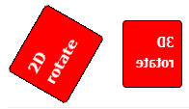

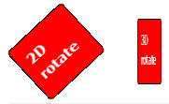
CSS3 2D Transforms
CSS3 transforms allow you to translate, rotate, scale, ,skew, matrix elements.
A transformation is an effect that lets an element change shape, size and position.
CSS3 supports 2D and 3D transformations.

Slide 27
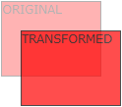

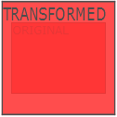
The translate() Method
The translate() method moves an element from its current position (according to the parameters given for the X-axis and the Y-axis).
The rotate() Method
The rotate() method rotates an element clockwise or counter-clockwise according to a given degree.
The scale() Method
The scale() method increases or decreases the size of an element (according to the parameters given for the width and height).

Slide 28
The skewX() Method
The skewX() method skews an element along the X-axis by the given angle.
The skewY() Method
The skewY() method skews an element along the Y-axis by the given angle.
The skew() Method
The skew() method skews an element along the X and Y-axis by the given angles.
skews the <div> element 20 degrees along the X-axis, and 10 degrees along the Y-axis:

Slide 29
The matrix() Method
The matrix() method combines all the 2D transform methods into one.
The matrix() method take six parameters, containing mathematic functions, which allows you to rotate, scale, move (translate), and skew elements:
The parameters are as follow: matrix(scaleX(),skewY(),skewX(),scaleY(),translateX(),translateY())
Matrix3d (n,n,n,n,n,n,n,n,n,n,n,n,n,n,n,n)
Defines a 3D transformation, using a 4x4 matrix of 16 values

Slide 30
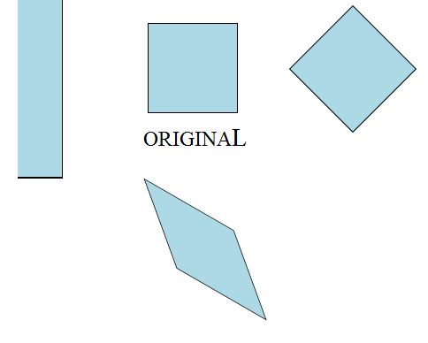
Class Work

Slide 31
CSS3 3D Transforms
CSS3 allows you to format your elements using 3D transformations.
rotateX()
rotateY()
rotateZ()
The rotateX() method rotates an element around its X-axis at a given degree
The rotateY() method rotates an element around its Y-axis at a given degree
The rotateZ() method rotates an element around its Z-axis at a given degree:

Slide 32
CSS3 Transitions
CSS3 transitions allows you to change property values smoothly (from one value to another), over a given duration.
How to Use CSS3 Transitions?
the CSS property you want to add an effect to
the duration of the effect
The transition effect will start when the specified CSS property (width) changes value.
Notes:
Note: If the duration part is not specified, the transition will have no effect, because the default value is 0.
The following example shows a 100px * 100px red <div> element. The <div> element has also specified a transition effect for the width property, with a duration of 2 seconds:

Slide 33
CSS3 Transform Properties
Property | Description
transform | Applies a 2D or 3D transformation to an element
transform-origin | Allows you to change the position on transformed elements
transform-style | Specifies how nested elements are rendered in 3D space
perspective | Specifies the perspective on how 3D elements are viewed
perspective-origin | Specifies the bottom position of 3D elements
backface-visibility | Defines whether or not an element should be visible when not facing the screen

Slide 34
CSS3 Animations
CSS3 animations allows animation of most HTML elements without using JavaScript or Flash!
What are CSS3 Animations?
An animation lets an element gradually change from one style to another.
You can change as many CSS properties you want, as many times you want.
To use CSS3 animation, you must first specify some keyframes for the animation.
Keyframes hold what styles the element will have at certain times.

Slide 35
The @keyframes Rule
Specify CSS styles inside the @keyframes rule, the animation will gradually change from the current style to the new style at certain times.
To get an animation to work, you must bind the animation to an element.
binds the "example" animation to the <div> element. The animation will lasts for 8 seconds, and it will gradually change the background-color of the <div> element from "red" to "yellow":

Slide 36
Note: If the animation-duration property is not specified, the animation will have no effect, because the default value is 0.
In the example above we have specified when the style will change by using the keywords "from" and "to" (which represents 0% (start) and 100% (complete)).
It will change the background-color of the <div> element when the animation is 25% complete, 50% complete, and again when the animation is 100% complete:

Slide 37
Animation can be
Multiple color change
Position Change
Reverse animation
The animation-delay property specifies a delay for the start of an animation.
The animation-iteration-count property specifies the number of times an animation should run.
The animation-direction property is used to let an animation run in reverse direction or alternate cycles.
The animation-timing-function property specifies the speed curve of the animation.

Slide 38
animation-timing-function property can have the following values:
ease - specifies an animation with a slow start, then fast, then end slowly (this is default)
linear - specifies an animation with the same speed from start to end
ease-in - specifies an animation with a slow start
ease-out - specifies an animation with a slow end
ease-in-out - specifies an animation with a slow start and end
cubic-bezier(n,n,n,n) - lets you define your own values in a cubic-bezier function

Slide 39
Specifies whether the animation is running or paused
div { -webkit-animation-play-state: paused; /* Safari 4.0 - 8.0 */ animation-play-state: paused; }
animation-fill-mode
Specifies a style for the element when the animation is not playing (before it starts, after it ends, or both)
div { -webkit-animation-fill-mode: forwards; /* Safari 4.0 - 8.0 */ animation-fill-mode: forwards; }

Slide 40




